Slide 1
RoboNUI Design
Jon Eisen
Thor Kirkby

Slide 2
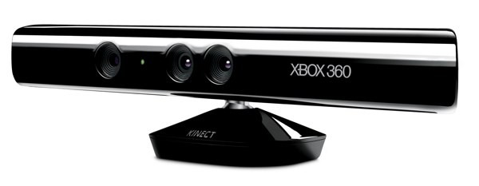
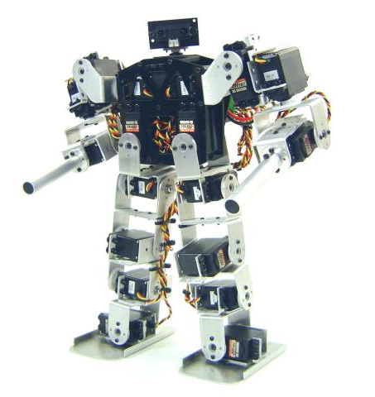
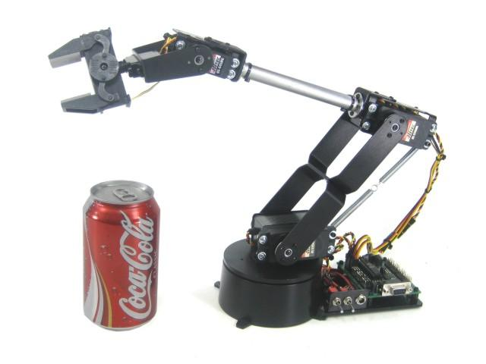
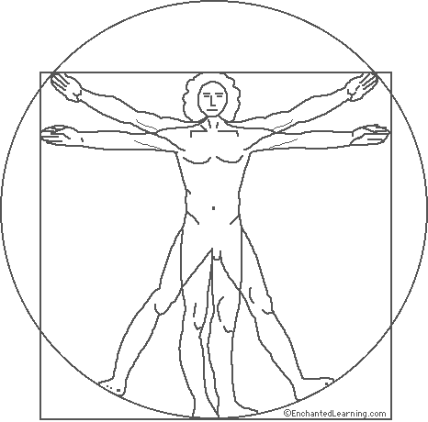
RoboNUI System Architecture
GUI
Record/Playback
Core Business Logic
Kinect Adapter
Robotics Adapter

Slide 3
RoboNUI Software Layer Design
GUI Assembly
Record / Playback Assembly
RoboNUI Core Business Logic Assembly
Kinect Adapter Assembly
Servo Adapter Assembly
Microsoft Kinect SDK
Windows Voice Recognition Library
Microsoft Visual C# .NET Framework
Microsoft Kinect Drivers
LynxMotion Servo Drivers
Microsoft Windows 7

Slide 4
Requirements
The robot moves along with the motion of the controller.
The Kinect Adapter measures the angles of each joint of the controller.
The Kinect Adapter can identify the angle of each joint of the robot.
The robot’s servos move at a pace consistent with general use of this system.
The robot should have a range of motion consistent with normal human motion.
The controller should be able to use voice commands.
The Kinect Adapter should be able to distinguish which controller spoke.
The Kinect Adapter should be able to recognize simple speech phrases to allow voice commands.
The Kinect Adapter should be able to switch primary controllers on a voice command.
The system should allow recording and playback of motions.
The Record/Playback should listen to commands sent to the robot.
The recorded commands should be stored in a minimal text format.
Playback should mimic the robot’s movements during the recording phase exactly.
The GUI should be helpful and minimal.
The GUI should display a skeletal view of the controllers.
The GUI should display a view of the robot’s current state.
The GUI should allow for controller switching.
The GUI should allow for control of record/playback.

Slide 5
Component-Based Architecture
GUI Assembly
Record / Playback Assembly
GUI
Recorder
Playback
RoboNUI Core Business Logic Assembly
State Manager
Joint-Angle Translator
Kinect Adapter Assembly
Servo Adapter Assembly
Skeletal Joint Monitor
Voice Command Interpreter
Robotic Arm Servo Controller
Robotic Marionette Servo Controller

Slide 6
RoboNUI Software Model
State Manager
Recorder
Voice Command Interpreter
GUI
Skeletal Joint Monitor
Robotic Arm Servo Controller
Joint-Angle Translator
Robotic Marionette Servo Controller
Playback

Slide 7
RoboNUI Software Model Primary Control Path
The Recorder records exact commands send to the servo controllers
Requested Joints are passed to the JAT
Recorder
Kinect Drivers send raw data
Joints are translated into Robotic Angles
Only one servo controller is on at any one time
Skeletal Joint Monitor
Robotic Arm Servo Controller
Joint-Angle Translator
Robotic Marionette Servo Controller
Playback
The angles are then converted into servo commands

Slide 8
RoboNUI Software Model State Management
State Manager
Recorder
Voice Command Interpreter
GUI
The VCI or GUI can send commands to the State Manager
Record and Playback are controlled by the State Manager
Skeletal Joint Monitor
The SJM or Playback component are enabled and disabled mutually exclusively
Playback

Slide 9
Schedule
Turn 1 - Core
SJM – Implement the monitoring of Joints based on a list given
JAT – Implement Joint Translation to robot angles based on robot configuration
Turn 2 - Control
SM – Implement control of the primary path of data (on/off, selection of data feeds)
GUI – Implement 3 parts [skeletons, robot state, control buttons & connected lights]
Turn 3 - Extended
R/P – Create a text format for record and playback. Implement store and load functionality, as well as streaming of robot commands
Update other components to work with R/P: SM, GUI, VCI
RSC – Implement one RSC (arm or marionette)
SM – Stub this such that the system turns on when executed
VCI – Implement voice commands as alternate to GUI, selection on controller
Open Development time / Buffer
7/27
8/23
9/13
10/4
August September October

